Slide 1



Level 2 health
Term 2 | week 1
Mon 28 April
Vision
Alfriston College is a learning community dedicated to developing and supporting lifelong independent learners by creating an environment that fosters a sense of Belonging, values Learning, and expects Success.

Slide 2


Do now
In groups of 4 share the following about your school holidays (they all have to be different):
One person you spent to with and what you did
One way you looked after your physical well-being
One thing you did to help someone out
The highlight of my school holidays was…

Slide 3
My resilient role model
Awaiting moderation
Learners who did not submit have been emailed to have this handed in today - please see me to discuss
80% have been marked
Resubmissions to be completed by end of the week - please see me to discuss

Slide 4
Learning intention
To build knowledge of hauora
Success criteria
Identify and explain the four dimensions of hauora
Identify strengths and challenges I have with my own hauora
Create a SMART goal centred around your hauora for this term
L2 health

Slide 5

What is hauora?
To build knowledge of hauora
Te whare tapa wha
hauora

Slide 6

Group task
In groups of 4, come up with a definition or a way to explain each of the four dimensions. Be prepared to share these back with the rest of the class
Te whare tapa wha
hauora

Slide 7
Te whare tapa wha
Taha tinana taha whanau
Taha wairua taha hinengaro
hauora

Slide 8
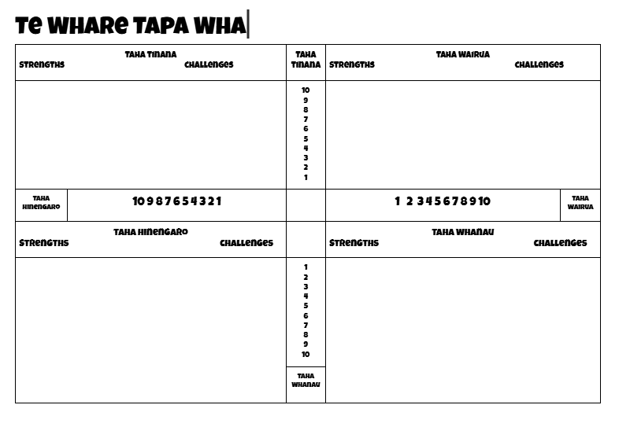
Independent task
Complete the independent worksheet and self-assess your current hauora
hauora

Slide 9
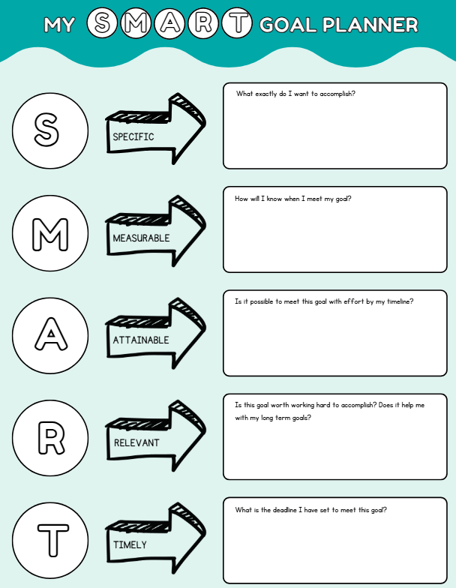
What is a smart goal?
Specific
I want to get fit
I am going to start running to improve my fitness
Measurable
I will run as much as possible
I will run 3x per week for 8 weeks
Achievable
I will run for at least 20 minutes
I will start running 1.5km in wk 1, then run 2km and keeping adding more distance each week until I can run..
Smart goals

Slide 10
What is a smart goal?
Relevant
I want to be able to run a as far as possible…
I want to be able to run 5km at a running event
Timely
I want to run as much as possible as often as I can
I want to be able to run 5km in under 30mins by the end of 8 weeks of training
Smart goals

Slide 11
Create a smart goal
Think of a goal you would like to achieve to improve a dimension(s) of your hauora
Complete the worksheet ⏩
Get this checked by LL
Collect a Heart piece of paper
Write your SMART goal inside the heart, colour this and make sure your name is visible on the front
Laminate for our wall
Smart goals

Slide 12
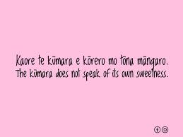
Do now - lesson 2
In groups discuss what you think this whakatauki means

Slide 13
Learning intention
Build knowledge of mana to enhance your self-identity
Success criteria
Identify how you or someone else demonstrates mana
L2 health

Slide 14
What is mana?
Mana can be defined in English as a person’s authority, control, influence, prestige, self-concept, or power.
It is also about honour, integrity, and social standing. It can be a source of both personal and collective strength, pride, and identity.
There are two things that we can be certain of mana:
(1) it is something that can be felt when you’re in the presence of it, (2) it goes hand in hand with respect and honour.
The best way to think of mana is to think of a person who has that air of importance about them. When that person walks into a room, speaks, or starts to do “their thing”, even if you have never met the person before, you will instantly be alert to their presence.
mana

Slide 15
Types of mana
Traditionally, there are three kinds of mana.
Mana whakaheke
The mana a person is born with This mana comes from the whakapapa, or the genealogy, of the person. This could be the status/ reputation of the parents, grandparents, great-grandparents right back to the people who came across on the waka (canoes), or those who descend from royalty or well-known families.
There is also mana from being descendants of tūpuna (ancestors) who are well known for their deeds. Some whānau (families) are known for certain skills, traits, and abilities which come from their tūpuna. This is similar to how there are families today who are known for their sporting, business, musical, or political skills.
mana

Slide 16
Types of mana
Mana tuku
The mana that the people give you This is the recognition that people give for your deeds and actions. Just because a person is born from a great descent line, it does not necessarily mean that they will have great mana amongst other people. The mana a person is born with sets them off, but the way they conduct themselves throughout life will either strengthen their own personal mana—and by association the mana of their tūpuna—or weaken their own personal mana. Humility is a very highly valued trait in the Māori world. Many great leaders are very humble people, which is part of why they are revered. Other people sing their praises, thereby heightening their mana. From a Māori worldview, great leaders never sing their own praises. It is not that they are trying to be humble, it is that they just are. Mana is attributed to someone by others—not by themselves. It is not appropriate to seek mana by telling people about how important you think you are.
mana

Slide 17
Types of mana
Mana ā-rōpu—group mana
This is the mana that a group has; for example, the mana of a marae, church, or group (for example, the kapa haka teams that win Te Matatini each year). This is often enhanced by mana tuku. When people stay on a marae, and are well looked after and are given great food, those manuhiri when they leave will tell everyone about the great experience, how well they were looked after, and the great food, which builds the mana of that marae and of the tangata whenua there. On the other hand, if the manuhiri were not looked after well, they would be fast to tell everyone about that also, hence weakening the mana of the particular marae involved and the tangata whenua there. Other forms of mana ā-rōpu are the mana of a whānau, a hapū, and an iwi.
mana

Slide 18
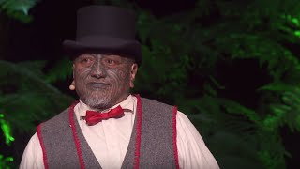
Tama iti
mana

Slide 19
Make a copy of the next three slides and answer the questions:
Think of someone in your whakapapa, family, or local community who you admire because they have mana. Record and then discuss the following questions in a small group.
mana

Slide 20
Mana whakaheke
(a) What does this person do that causes you to admire him/her?
(b) How do their behaviours/actions benefit others?
(c) If you could describe this person in five words, what would they be?
(d) Do you have any of these same qualities?
mana

Slide 21
Mana tuku
(a) Why are the qualities/skills described above important or useful?
(b) How might these qualities help people to be successful in life?
(c) How might you develop these qualities/skills?
mana

Slide 22
Mana ā-rōpu
(a) How do qualities like this help you to build and sustain relationships with others?
(b) How might these qualities/skills be used to help/be of service to your whānau/community?
(c) Collate all of the qualities identified by members of your group and consider which of these qualities you possess. In what contexts/places do you get a chance to practise/show them? How do they help you in life?
mana

Slide 23
Extension - manaakitanga
Manaakitanga is a commonly used word in schools in Aotearoa. It is usually used to refer to the importance of “hospitality” and/or caring for others. However, the word manaaki is made up of two words: “mana” (pride/positive self-concept) and “aki” (to cherish or nurture). Therefore, to manaaki others is to do things that cherish their mana. We might manaaki our grandmother by doing chores for her, or manaaki our best friend by helping them prepare for an important social event. The point is that we do these things because we want to show them that we care and affirm their importance in our life.
How do you manaaki those around you?
To what effect?
How do others manaaki you?
What does this mean to you?
mana

Slide 24
Level 2 health
Term 2 | week 1
Mon 28 April
Vision
Alfriston College is a learning community dedicated to developing and supporting lifelong independent learners by creating an environment that fosters a sense of Belonging, values Learning, and expects Success.

Slide 25

Do now
Collect your SMART goals worksheet
If incomplete, please complete and laminate
If/when completed and laminated, cut our the heart and SMART goal. Collect some velcro dots (rough side) and hand in to LL
Once you have completed (3) start working on your Mana questions and answers on your Slides Doc

Slide 26
Learning intention
To build knowledge of our Gender and Sexuality
Success criteria
Identify differences between gender and sexuality
Identify key terms used for gender and sexuality
L2 health

Slide 27
Gender
While many people assume that gender is fixed or stable, it is actually a social construct.
The World Health Organisation (WHO) defines gender as follows:
Gender refers to the socially constructed characteristics of women and men—such as norms, roles and relationships of and between groups of women and men.
It varies from society to society and can be changed. While most people are born either male or female, they are taught appropriate norms and behaviours—including how they should interact with others of the same or opposite sex within households, communities and workplaces.
gender

Slide 28
When individuals or groups do not ‘fit’ established gender norms they often face stigma, discriminatory practices or social exclusion—all of which adversely affect health. It is important to be sensitive to different identities that do not necessarily fit into binary male or female sex categories.
Gender norms, roles and relations influence people’s susceptibility to different health conditions and diseases and affect their enjoyment of good mental, physical health and wellbeing. They also have a bearing on people’s access to and uptake of health services and on the health outcomes they experience throughout the life-course.
Gender is different from sexuality and from biological sex. Rainbow Youth NZ (www.ry.org.nz/genderidentity/) states that: Gender refers to the gender that someone identifies with, while sex usually refers to the sex someone is assigned at birth. It can be helpful to think of it as: sex is between your legs and gender is in your head/heart.
gender

Slide 29
Sex
Assigned sex is a label that you’re given at birth based on medical factors, including your hormones, chromosomes, and genitals. Most people are assigned male or female. When someone’s sexual and reproductive anatomy doesn’t seem to fit the typical definitions of female or male, they may be described as intersex. Some people call the sex we’re assigned at birth “biological sex”. But this term doesn’t fully capture the complex biological, anatomical, and chromosomal variations that can occur. Having only two options (biological male or biological female) might not describe what’s going on inside a person’s body. Instead of saying “biological sex”, some people use the phrase “assigned male at birth” or “assigned female at birth”.
This acknowledges that someone (often a doctor) is making a decision for someone else. The assignment of a biological sex may or may not align with what’s going on with a person’s body, how they feel, or how they identify. (www.plannedparenthood.org)
sex

Slide 30
Sexuality
A central aspect of being human throughout life encompasses sex, gender identities and roles, sexual orientation, eroticism, pleasure, intimacy, and reproduction.
Sexuality is experienced and expressed in thoughts, fantasies, desires, beliefs, attitudes, values, behaviours, practices, roles, and relationships. While sexuality can include all of these dimensions, not all of them are always experienced or expressed.
Sexuality involves the interaction of biological, psychological, social, economic, political, cultural, legal, historical, religious, and spiritual factors. (World Health Organization, 2006). Everyone has sexuality regardless of whether they are sexually active. Sexuality can be thought of as how you enjoy having sex, which often encompasses sexual behaviour and sexual orientation.
sexuality

Slide 31
Sexual Orientation
Sexual orientation is about attraction. It can be fluid and change over time. Some people are attracted to males, some to females, some people are attracted to neither, in between, or both. Sexual orientation is about who you’re attracted to and who you feel drawn to romantically, emotionally, and sexually. Sexual orientation can be described with terms like: heteroromantic, homoromantic, bi-romantic, panromantic, and aromantic. Using labels to define sexual orientation can both enable and disable discussions, and empower, disempower, or restrict people. Sexual orientation encompasses sexual behaviour, in that people generally are sexually attracted to the people they are romantically attracted to (this is not always the case). The term “straight” implies heteroromanticism and heterosexuality, while gay/lesbian implies the opposite (homoromanticism and homosexuality). Language and labels can get confusing as “bisexual” means bi-romantic and bisexual to varying degrees, or when asexual or aromantic labels are
Sexual orientation

Slide 32
Gender, Sex & Sexuality
Watch this video and write down 5 key points about:
Gender
Sex
Sexuality
Gender, sex & Sexuality

Slide 33

task
In pairs, list as many terms for gender identity that you know of
Key terms
Now, check this document out a read through some key terms related to Gender

Slide 34
Level 2 health
Term 2 | week 2
Mon 5 may - l1
Vision
Alfriston College is a learning community dedicated to developing and supporting lifelong independent learners by creating an environment that fosters a sense of Belonging, values Learning, and expects Success.

Slide 35
Do now
“Gender and sexual identity is complex and fluid. It’s OK to be who you are and to feel a mix of things. Identity can change over time.”
Discuss in pairs what you think this means?
L2 health

Slide 36
Learning intention
To build knowledge of 2.5 Gender and Sexuality Assessment
Success criteria
Read the entire 2.5 Gender and Sexuality Assessment
Complete the associated assessment questions
L2 health

Slide 37
2.5 gender and sexuality assessment
In pairs read the entire assessment
Once you have read the assessment, completed the following questions in a book (not your chromebook:
What is the title of the assessment?
What does the assessment require you do?
Explain the difference between the 3 achievement levels?
When is this assessment due?
How many parts are there to the assessment?
How many credits is it worth?
What knowledge does this assessment require?
What questions do you have about the assessment?
L2 health

Slide 38
Class task
As a class we will go through the questions together and learners will have the opportunity to ask questions about the assessment at the end:
What is the title of the assessment?
What does the assessment require you do?
Explain the difference between the 3 achievement levels?
When is this assessment due?
How many parts are there to the assessment?
How many credits is it worth?
What knowledge does this assessment require?
What questions do you have about the assessment?
L2 health

Slide 39
Reflection task
Think to yourself where you sit on this continuum
Share your thoughts at your table on whether you think people stay at one particular place on the continuum or move
Share your thinking on what influences/changes happen to people that make them more static (still) or dynamic (move) on the continuum
Lesbian/Gay
Straight/Heterosexual
Bisexual
Homosexual

Slide 40
Level 2 health
Term 2 | week 2
Mon 5 may - l2
Vision
Alfriston College is a learning community dedicated to developing and supporting lifelong independent learners by creating an environment that fosters a sense of Belonging, values Learning, and expects Success.

Slide 41
Learning intention
To build knowledge of Hauora, Sexuality and Strategies
Success criteria
Review Gender & Sexuality Learning
Identify impacts Sexuality has on our Hauora
Identify Personal (Self), Interpersonal (Others) & Societal (Society) strategies for promoting positive sexuality
L2 health

Slide 42
Review of gender & Sexuality learning
Key Terms
Gender - the social construct of male and female characteristics which includes norms, roles and relationships. Gender is fluid across male and female.
Gender Identity - what a person identifies with as their internal sense of their gender, this is not always guided by their sex.
Sex - the assigned biological label you are given at birth
Sexuality - involves people's attitudes, values, beliefs and feelings about others and their relationships, sexual behaviour, sexual orientation and identity.
Sexual Orientation - who you are attracted to romantically and sexually. Can be fluid
Review of learning

Slide 43
Hauora & Sexuality
Everyone experiences sexuality it has an impact on wellbeing/hauora. This is especially relevant for youth as their are many changes happening in adolescence that are influencing youth and their sexuality as the move into adulthood. Therefore, it is important youth have a clear understanding of the impact of sexuality on their hauora - most importantly the promotion of positive sexuality!
Hauora & Sexuality

Slide 44
Hauora & Sexuality
Here are some examples of Sexuality that youth may experience on their Hauora
Taha tinana (physical) - puberty body changes, affection, body confidence
Taha wairua (spiritual) - sexual identity, confident in knowing what positive relationships
Taha hinengaro (emotional/mental) - boundaries and consent
Taha whanau (social) - intimate relationships, trusting relationships with friends about personal sexual matters
Hauora & Sexuality

Slide 45
TAHA TINANA
(Physical)
List as many positive and negative impacts Sexuality has on our
Positive impacts negative impacts
PUBERTY
SPORT
DANCE
SEX EDUCATION
(SEX)
Hauora & Sexuality

Slide 46
TAHA WHANAU
(SOCIAL)
List as many positive and negative impacts Sexuality has on our
Positive impacts negative impacts
INTIMATE RELATIONSHIPS
FRIENDSHIPS
WHANAU
SEX EDUCATION
(SEX)
Hauora & Sexuality

Slide 47
TAHA HINENGARO
(MENTAL/EMOTIONAL)
List as many positive and negative impacts Sexuality has on our
Positive impacts negative impacts
CONSENT
QUALITY OF INTIMATE RELATIONSHIPS
SELF CONFIDENCE
Hauora & Sexuality

Slide 48
TAHA WAIRUA
(SPIRITUAL)
List as many positive and negative impacts Sexuality has on our
Positive impacts negative impacts
RELIGION
SEXUAL IDENTITY
RELATIONSHIP VALUES
& BELIEFS
Hauora & Sexuality

Slide 49
Level 2 health
Term 2 | week 2
Tues 6 may
Vision
Alfriston College is a learning community dedicated to developing and supporting lifelong independent learners by creating an environment that fosters a sense of Belonging, values Learning, and expects Success.

Slide 50
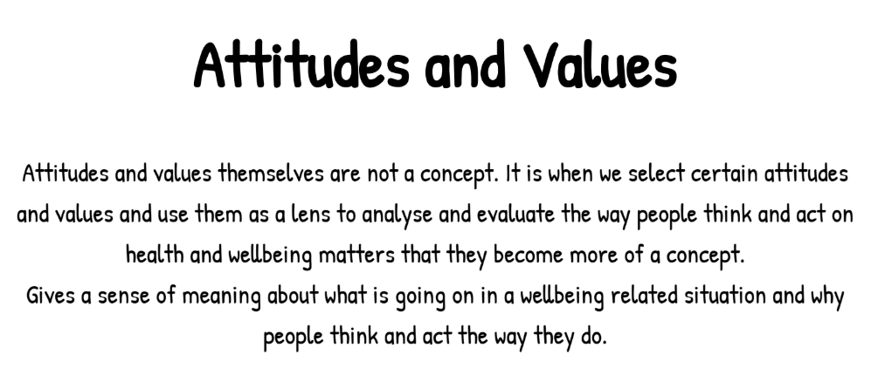
Do now
Read the above description on Attitudes and Values
Name one person who influences your attitudes and values and explain why?
Name one societal influence that influences your attitudes and values and why?

Slide 51
Learning intention
To build knowledge of Attitudes and Values and PIPS
Success criteria
Review the socio-ecological perspective - Personal, Interpersonal, Societal
Identify and explain strategies related to gender and sexuality scenarios
L2 health

Slide 52
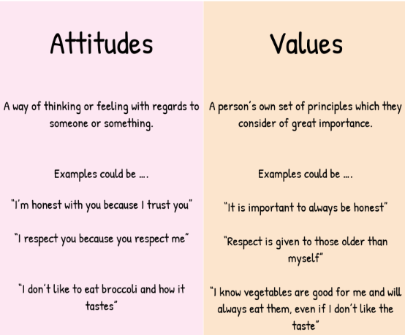
Attitudes & values

Slide 53
Complete this table in your books. Under the attitudes and values column, write a statement that reflects your attitude towards the topic in the middle column
Attitudes - way of thinking of feeling towards something
Values - what rules you set for yourself as the right thing to do
Attitudes & values
Attitudes | Topic | Values
 | Marriage before Sex
 | Contraception
 | LBTQIA+
 | Monogamous Relationships
 | Women as Housewives

Slide 54
PERSONAL, INTERPERSONAL & sOCIETAL
Personal - actions that you are in control of yourself eg goal setting, self talk, journaling, physical exercise
Interpersonal - actions that involve working with others eg. friends, family, employment, teachers, church, school
Societal - actions that involve working with a group of people, community, organisation, media, government, health services, religion, education
In a health context we regularly recommend strategies to support people to work through any factors on a personal, interpersonal and societal level
P | IP | s

Slide 55
strategies
Strategies in a health context are actions one can take to enhance their well-being
Look at this scenario 1, then in pairs recommend a personal, interpersonal and societal strategy for this persons scenario:
Damian is unsure about his sexual orientation. He comes from a family of four brothers who are all very masculine and play rugby. Damian also plays rugby and gets along with his brothers. Damian has a few friends that have girlfriends and some that are single. Damian feels that he is more attracted to males than females and wants to be able to express this to someone who is not going to judge him and he is worried about losing his friendships through potentially “coming out.”
Personal
Interpersonal
Societal
P | IP | s

Slide 56
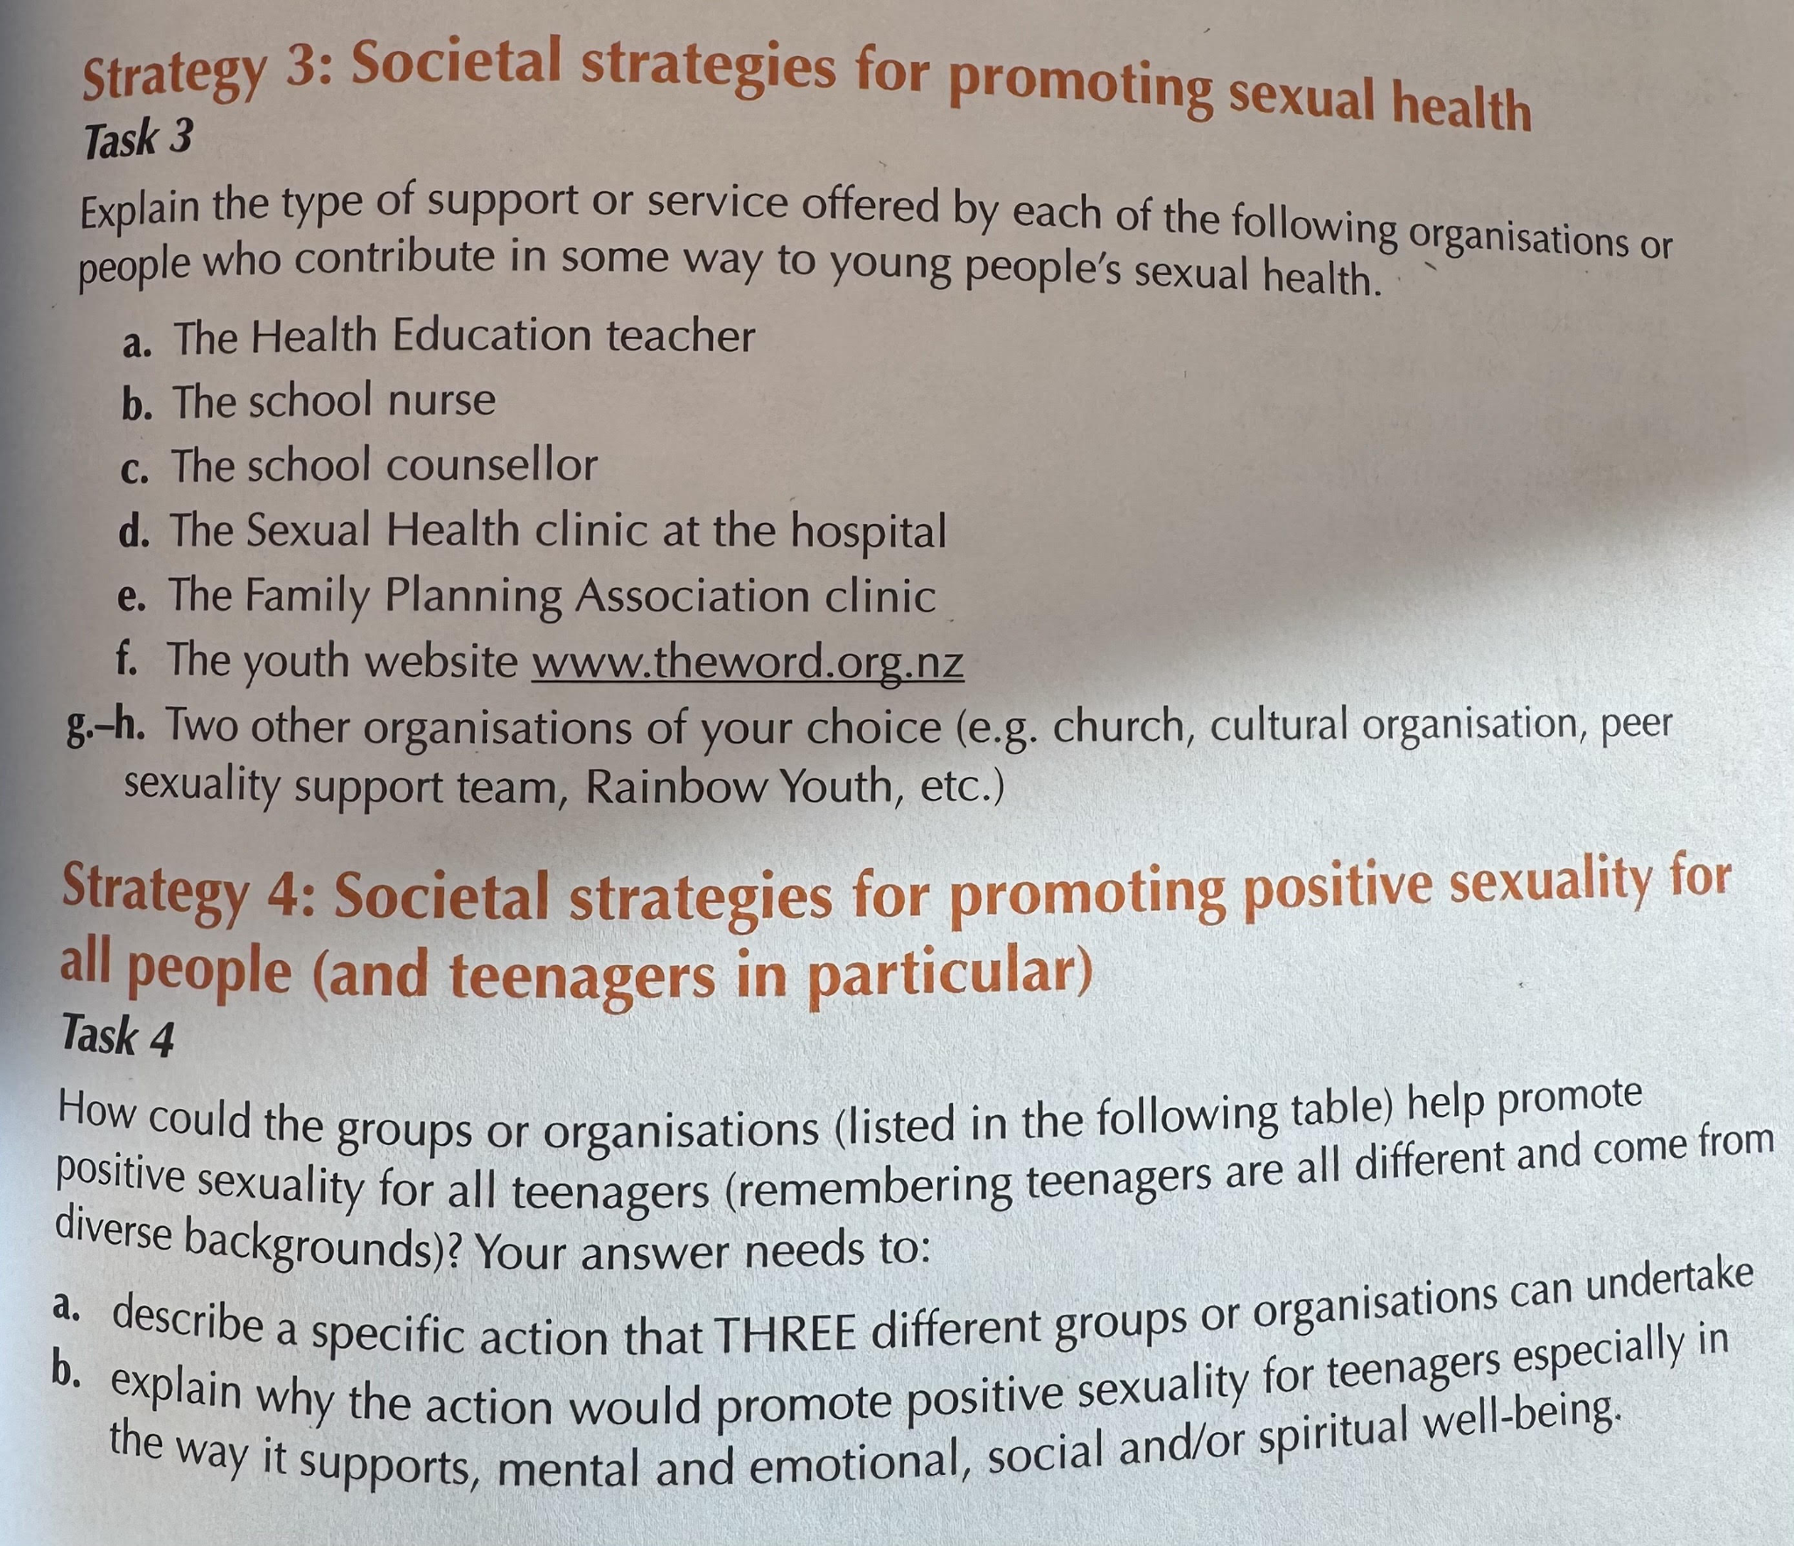
Strategy tasks 1
Complete the following task independently in your books:
P | IP | s

Slide 57
Strategy tasks 2
Complete the following task independently in your books:
P | IP | s

Slide 58

reflection
Write down three things you learnt today on a post it note
reflection

Slide 59
Do now
In groups of 3-4, complete the above task by using your knowledge of societal strategies

Slide 60
Learning intention
To build knowledge and make sense of stereotypes
Success criteria
Make sense of feminism
Identify stereotypes for men and women
Identify the problems associated with stereotyping and give examples
L2 health

Slide 61
brainstorm
In pairs, on a piece of paper write down 10 words you associate with the word feminism and write them up on the board
feminism

Slide 62
What is feminism?
Feminism is a social movement that began with women around the world fighting for the right to vote in the late 19th century. It has continued over the past 100+ years with second-wave feminism in the 1960s, third-wave feminism in the early 1990s, merging into the fourth-wave feminism of today.
These waves were all influenced by society at their respective times and included activism for women’s rights around sexual and reproductive health (especially in relation to access to the Pill and abortion) and to support in the workplace, access to childcare, equal pay, and a range of other equity issues.
feminism

Slide 63
What is feminism?
Feminism in contemporary times is seen as important for both men and women to be involved with, as it concerns gender equity and the rights of all people to self-determine, be treated with respect, and without violence or oppression. For more information, see: and www.rosie.org.au
feminism

Slide 64
Stereotypes a widely held but fixed oversimplified image or idea of a particular type of person or thing.
In pairs write down all the “stereotypes” society have of women and men
Once you have completed this write your words up on the board
women
men

Slide 65
Stereotypes
What are consequences of these stereotypes?
In pairs, pick three stereotype examples and write them down along with a reason why they are a problem
women
men
Feminism works to challenge these stereotypes so that men and women have more options and are more equal across contexts (work, home, in families, in sport, etc.).

Slide 66


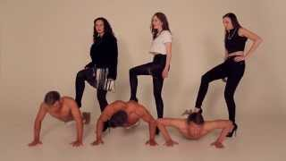
Do now - In groups of three
Watch both these videos, then in your groups of three answer the questions on the provided worksheet.
Once you have completed the worksheet, share your answers with another group
feminism

Slide 67
reflection
(a) How do these media messages affect me and my friends?
(b) Why are some media messages about gender a problem?
(c) Has this activity made me think differently about how music videos represent gender?
reflection

Slide 68
In groups of three
Watch both these videos, then in your groups of three answer the questions on the provided worksheet.
Once you have completed the worksheet, share your answers with another group
feminism

Slide 69
Learning intention
To build knowledge and make sense of the impacts of pornography
Success criteria
Identify issues related to the use of pornography
L2 health

Slide 70
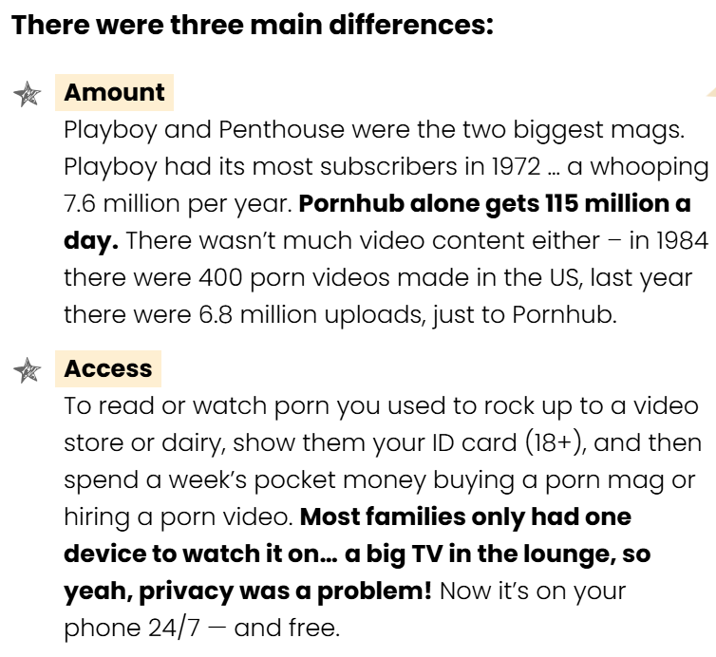
history
pornography

Slide 71
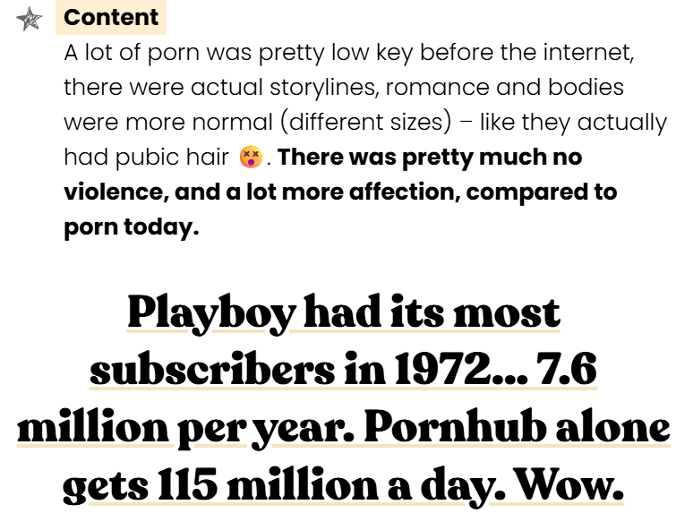
history
pornography

Slide 72
Current state
Pornography …. is defined as sexual action which depicts harm towards another human being ie degrades, violates, connects violence with sex, or involves the use of power over another individual or a group
Sources:
Social and Ethical Issues in Sexuality Education by Gillian Tasker et al. (Christchurch College of Education, 2000, and revised 2004)
pornography

Slide 73
Current state
“One in four young people in New Zealand first saw porn by the age of 12. Three out of four have seen it by 17. Most young people were not seeking out pornography when they first saw it, but they came across it anyway – it found them. Accidentally seeing porn is one thing, but some young people are viewing it regularly (15% view porn at least monthly, weekly, or daily). The majority of these regular viewers started looking at porn monthly, weekly or daily by age 14. Porn is an issue for girls and boys.
Sources:
Social and Ethical Issues in Sexuality Education by Gillian Tasker et al. (Christchurch College of Education, 2000, and revised 2004)
pornography

Slide 74
Current state
Boys are more likely to see porn earlier, to seek it out, and to view it more often. But girls are also exposed to pornography, often at a young age. The majority of 14-year old girls have seen porn. Around 10 percent of girls view it regularly.” That much of the easily accessed online pornography shows sexual acts that are violent, demeaning, dehumanising, or exploitative (especially of women, children, and young people), and with no consideration of consent, or pleasure for all involved.
The negative impact on relationships and overall wellbeing as a consequence of viewing this type of pornography as it creates new unhealthy ‘norms’ and unrealistic expectations of sexual behaviour
pornography

Slide 75

Group task
In groups 5, you will be issued one the below articles/resources to read through as a group.
In you group create a slides presentations, your slides will need to include:
5 key points that the article is making about porn
A summary of 100 words about what your group thinks about the article and what it is saying about pornography
6 slides maximum
All learners in your group must have a turn at speaking/presentation your findings to the class
Articles & Resources
RNZ The Light Project
The Spin Off Family First
Classification Office 1 - Pages 30-33
Classification Office 2 - Pages 34-37
pornography

Slide 76

Colour in the Pink Day Shirt image and write any anti-bullying slogans or words of empowerment around groups that maybe bullied for their Gender or Sexuality
Do now

Slide 77
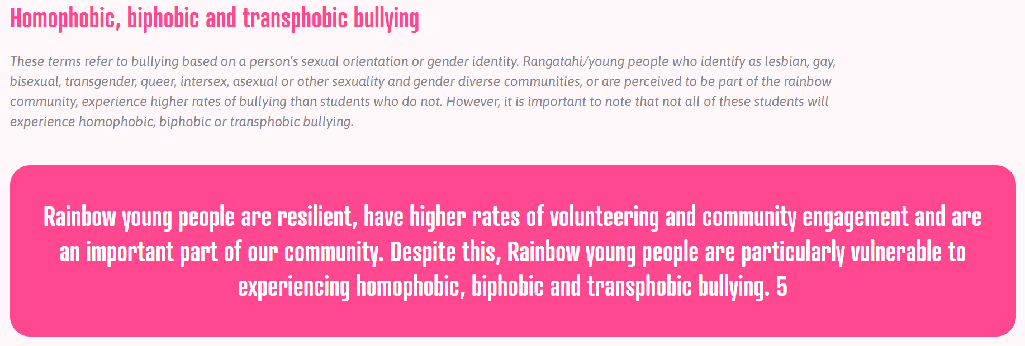

Slide 78
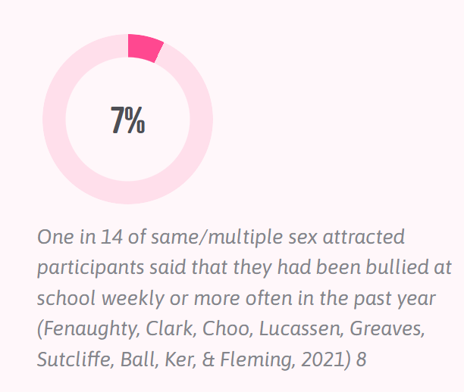
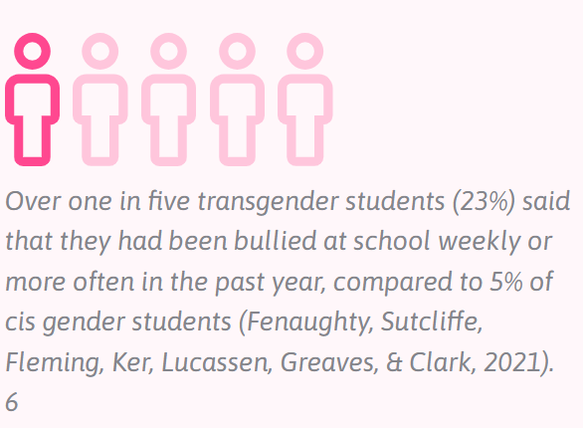
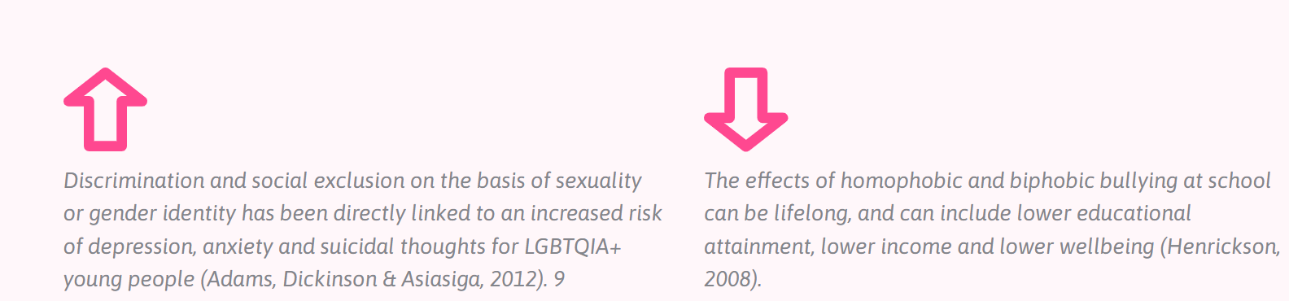
stats

Slide 79
Group task
In groups 5, you will be issued one the below articles/resources to read through as a group.
In you group create a slides presentations, your slides will need to include:
5 key points that the article is making about porn
A summary of 100 words about what your group thinks about the article and what it is saying about pornography
6 slides maximum
All learners in your group must have a turn at speaking/presentation your findings to the class
Articles & Resources
RNZ The Light Project
The Spin Off Family First
Classification Office 1 - Pages 30-33
Classification Office 2 - Pages 34-37
pornography

Slide 80
Group task
In groups come up with strategy on all levels for a learner that might be getting bullied because it has become common knowledge around school that their Sexual Orientation is Lesbian
personal int. personal societal
strategies

Slide 81
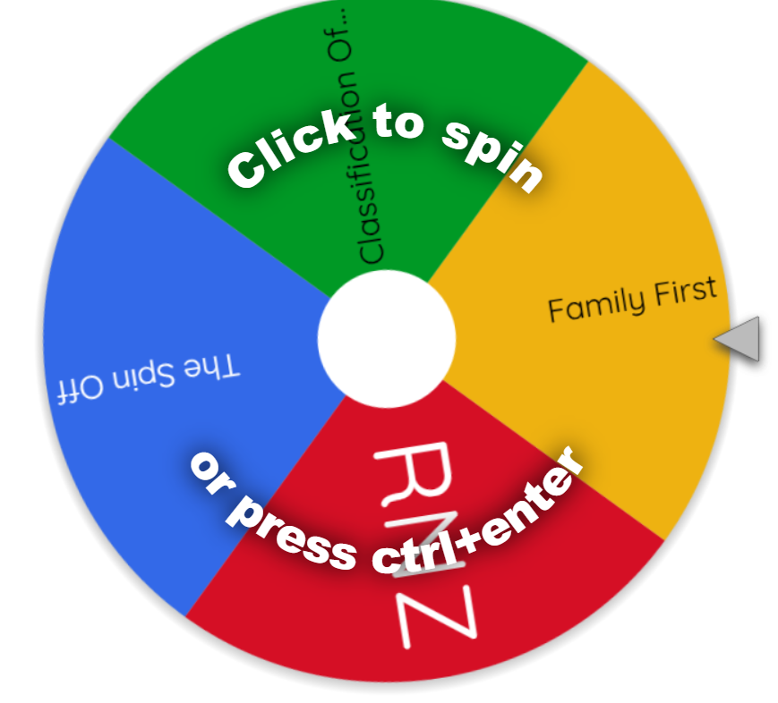
Spend 15 minutes preparing to present your group presentation on your article that relates to the impacts of pornography.
Spin the Wheel will decide the order of presentations
Do now

Slide 82
Whilst groups are presenting:
Be respectful and listen - no talking!
Take notes of statistics, key messages - these could be helpful for ideas to write about or include in your assessment
You will have to answer questions at the end of the presentation
presentations

Slide 83
Whilst groups are presenting:
Be respectful and listen - no talking!
Take notes of statistics, key messages - these could be helpful for ideas to write about or include in your assessment
You will have to answer questions at the end of the presentation
presentations

Slide 84
Assessment Writing
Timeline - 5 weeks
Four articles, complete one article each week (Wk 4 to 8). Use Wk 9 for editing, proofreading, checking.
Resources
Use links in slides to gather information
Any resources of information, link them into your assessment
Follow the instructions for each task
Each task asks you to “cover the following” in your articles make sure you stick to these guidelines - dont go off on a different direction
Read the Marking Criteria
Regularly check the marking criteria at the end of the assessment document to make sure you are meeting the requirements for the grade you are aiming for
2.5 gender & Sexuality

Slide 85
Click link and enter all the words/terms/ideas we have learnt today or covered in class in terms of Gender and Sexuality
https://www.menti.com/al6wrcd93mp2 - code: 24943288
Do now

Slide 86
Assessment Writing
Timeline - 5 weeks
Four articles, complete one article each week (Wk 4 to 8). Use Wk 9 for editing, proofreading, checking.
Resources
Use links in slides to gather information
Any resources of information, link them into your assessment
Follow the instructions for each task
Each task asks you to “cover the following” in your articles make sure you stick to these guidelines - dont go off on a different direction
Read the Marking Criteria
Regularly check the marking criteria at the end of the assessment document to make sure you are meeting the requirements for the grade you are aiming for
2.5 gender & Sexuality

Slide 87
TODAY
✅ Complete one of out four tasks for 2.5 assessment
✅ Complete one on one with Mrs Tamihere
✅ Start second task for 2.5 assessment
TOMORROW
Class tomorrow will be in AH.05 and be merged with Mr Murray’s GGP class
Please complete ensure that you have a chromebook and are working on your assessment during this class
2.5 gender & Sexuality

Slide 88
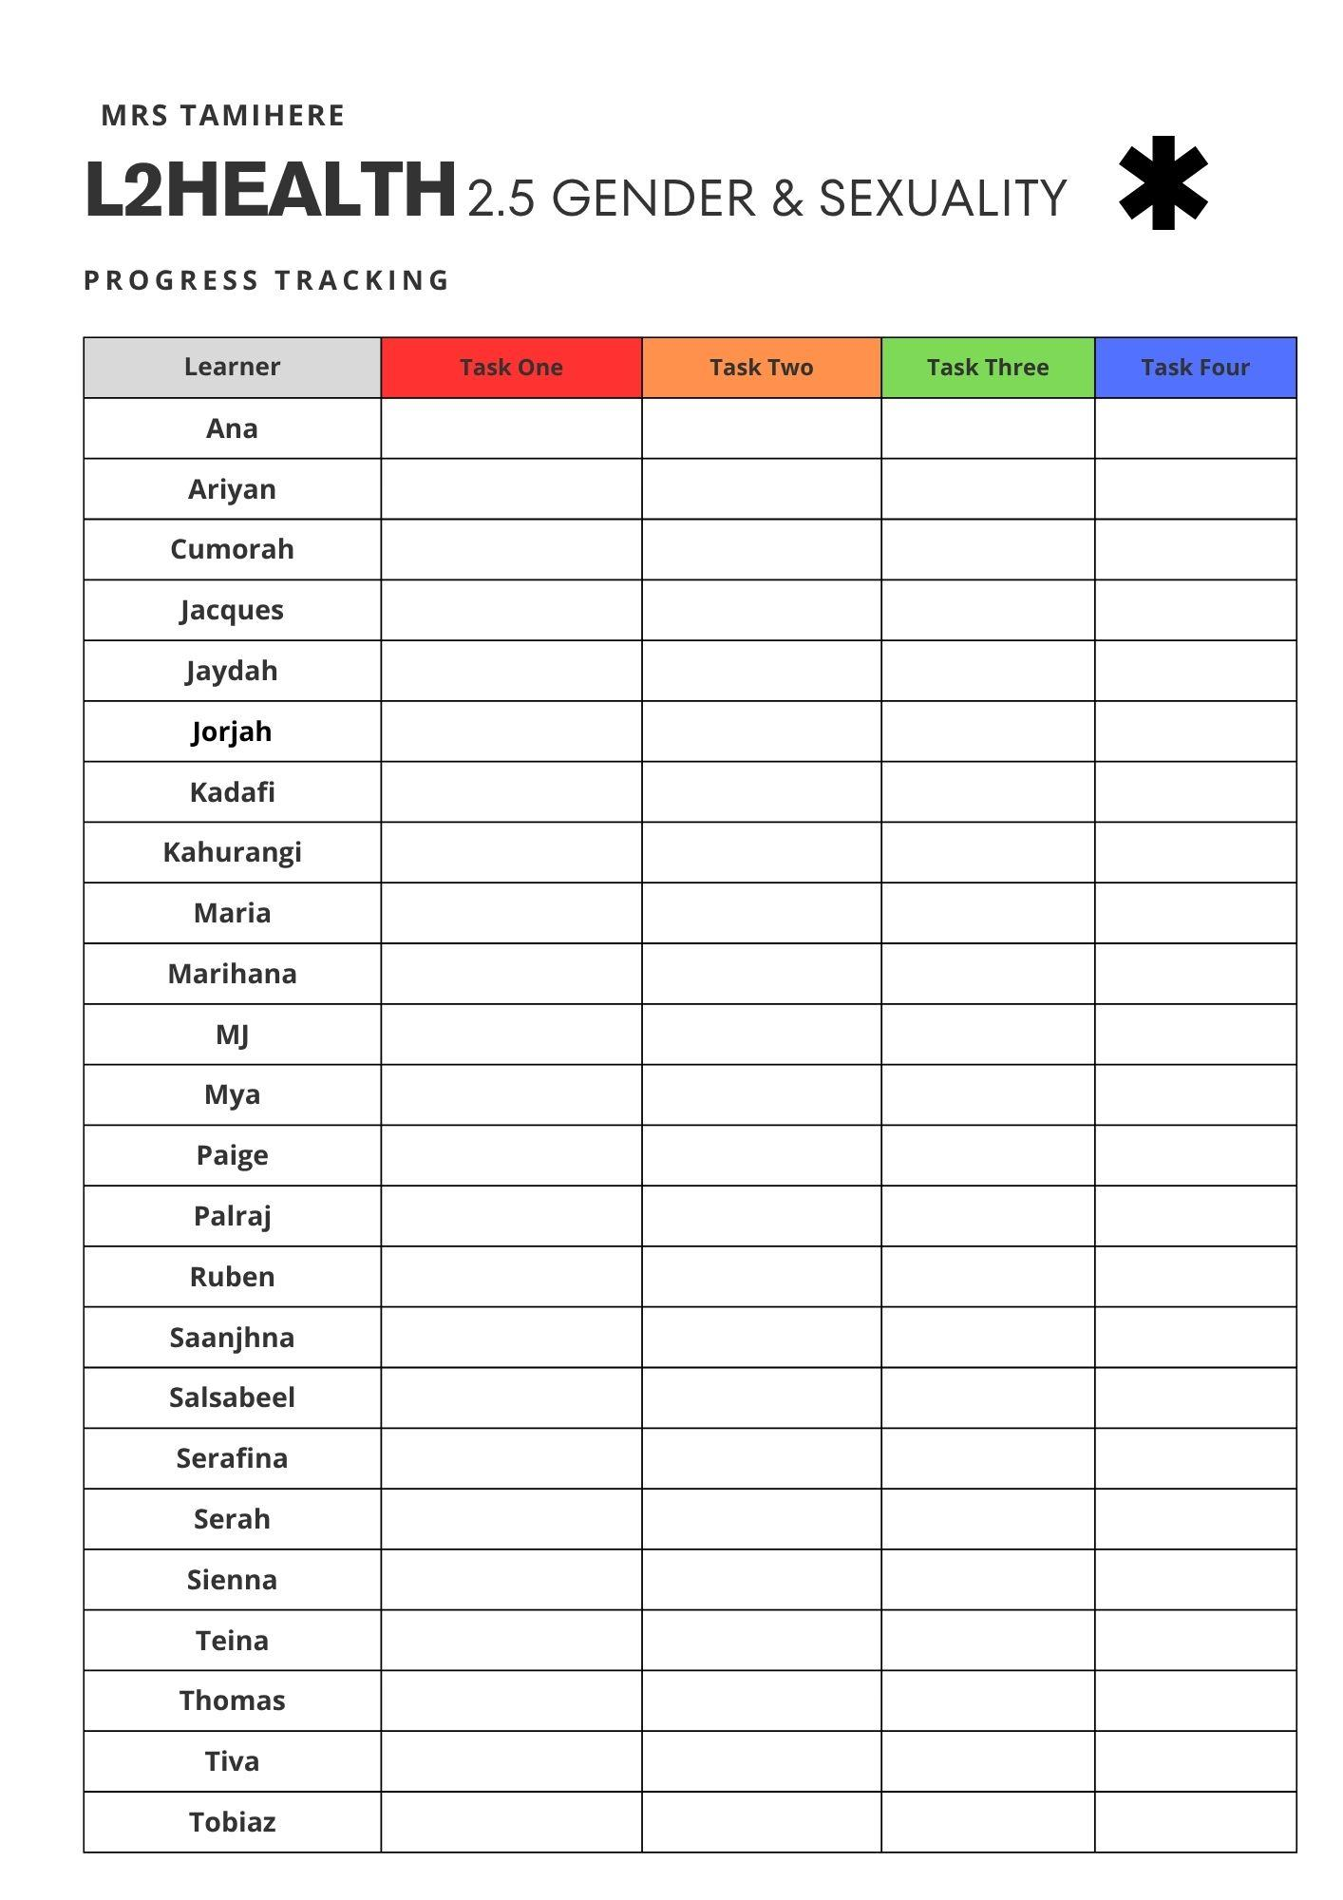
Wk.6
✅ Complete two of out four tasks for 2.5 assessment
✅ Get work checked by Mrs Tamihere once you have completed at least one task
✅ Check tasks off of our Tracking sheet for this assessment
2.5 gender & Sexuality

Slide 89
Wk. 7
✅ Complete three of out four tasks for 2.5 assessment
✅ Get work checked by Mrs Tamihere once you have completed at least one task
✅ Check tasks off of our Tracking sheet for this assessment
Library Lesson 2
2.5 gender & Sexuality

Slide 90
Wk. 8
✅ Complete 3-4 tasks for 2.5 assessment
✅ Get work checked by Mrs Tamihere once you have completed at least one task
✅ Check tasks off of our Tracking sheet for this assessment
2.5 gender & Sexuality

Slide 91
Timeline to Due Date - Friday 27 June midnight
Week 8
Mon - Lesson 1 & 2 - assessment writing
Tues - Lesson 3 - assessment writing in LIBRARY
Thurs - Staff Only Day
Friday - Matariki
Week 9
Mon - Lesson 1 & 2 - assessment writing
Tues - Lesson 3 - assessment writing
If you have course on a Tuesday this will reduce your assessment writing time during school
2.5 gender & Sexuality

